Slide 1




^{[1]}
^{[1]}
BAPUJI INSTITUTE OF ENGINEERING AND TECHNOLOGY
DAVANGERE
ACADEMIC YEAR:2021-2022
IBM Cognos Powered HR
and
People Analytics
Submitted by:
Akshatha S P 4BD19CS400
Komal S Rokhade 4BD19CS401
Yamini Niharika P 4BD18CS122
Thota Veda Sree 4BD18CS118

Slide 2
Introduction
HR analytics is defined as the process of measuring the impact of HR metrics, such as time to hire and retention rate on business performance.
HR analytics is a methodology for creating insights on how investments in human capital assets contribute to the success of four principal outcomes: (a) generating revenue, (b) minimizing expenses, (c) mitigating risks, and (d) executing strategic plans.
IBM Cognos Analytics provides dashboards and stories to communicate your insights and analysis.
You can assemble a view that contains visualizations such as a graph, chart, plot, table, map, or any other visual representation of data.

Slide 3
IBM Cognos Analytics
IBM Cognos is a web based reporting and analytic tool.
IBM Cognos provides a wide range of functionality to help you understand your organization's data.
A flexible workspace where user can explore their data or explore existing
asset in a dashboard or report.
Highly interactive and performant visualization.
Low barrier to entry: make it easy for any user to get started exploring.

Slide 4
Dashboard
A dashboard helps you to monitor events or activities at a glance by providing key insights and analysis about your data on one or more pages or screens.
User can flexibility to quickly assemble very attractive dashboard.
Meaningful visualizations are automatically generated with little authoring experience needed
Dashboards empower both technical and non-technical users to understand and leverage business intelligence to make more informed decisions.

Slide 5
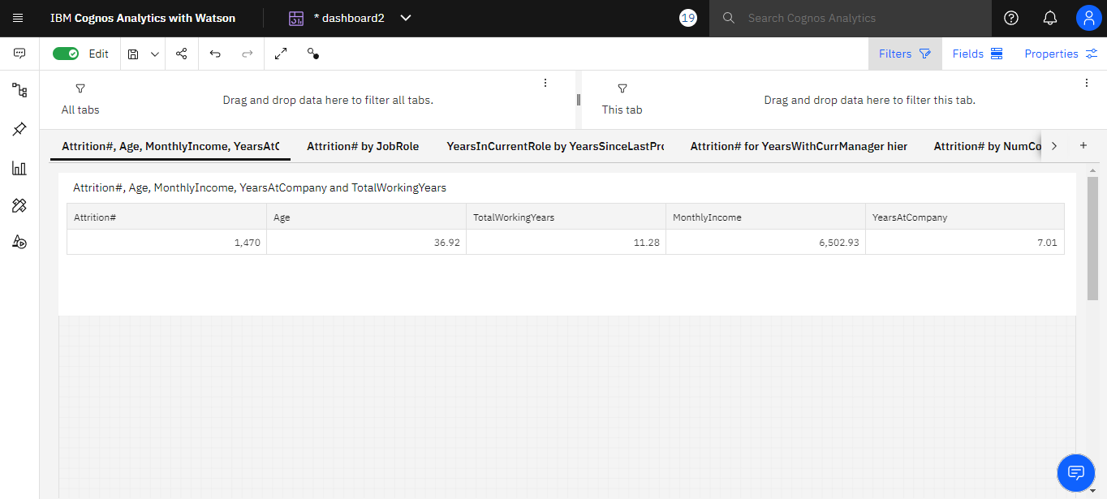
Figure 1:This figure shows the Analyzing Age, Total Working Years, Attrition, Years At Company And Monthly Income.

Slide 6
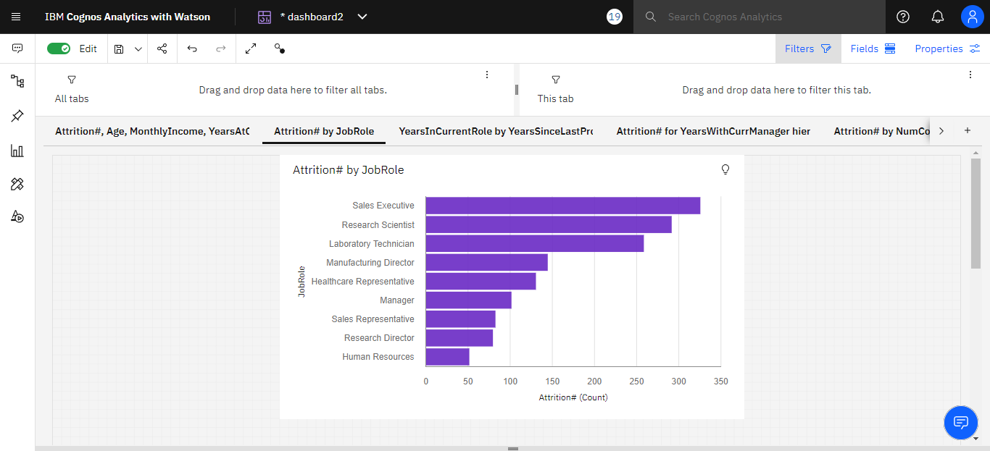
Figure 2: This figure shows the visualize attrition with respect to job role as a bar chart

Slide 7
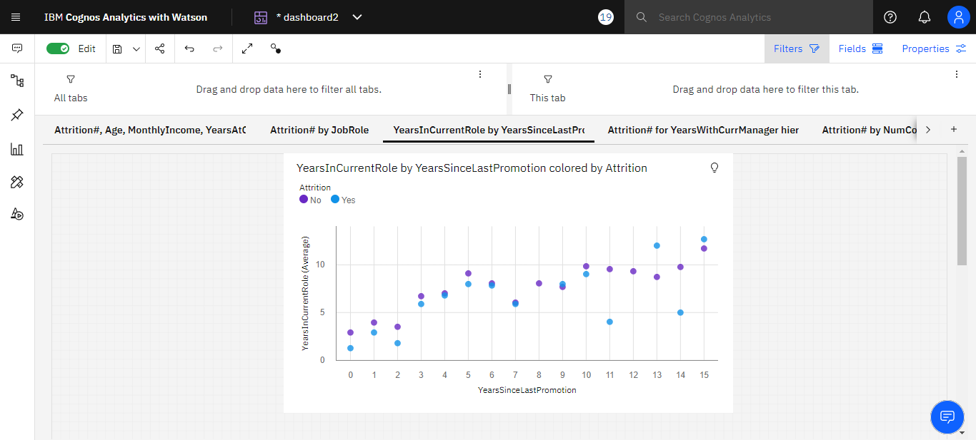
Figure 3: This page contains Years in Current role by Years since last promotion.

Slide 8
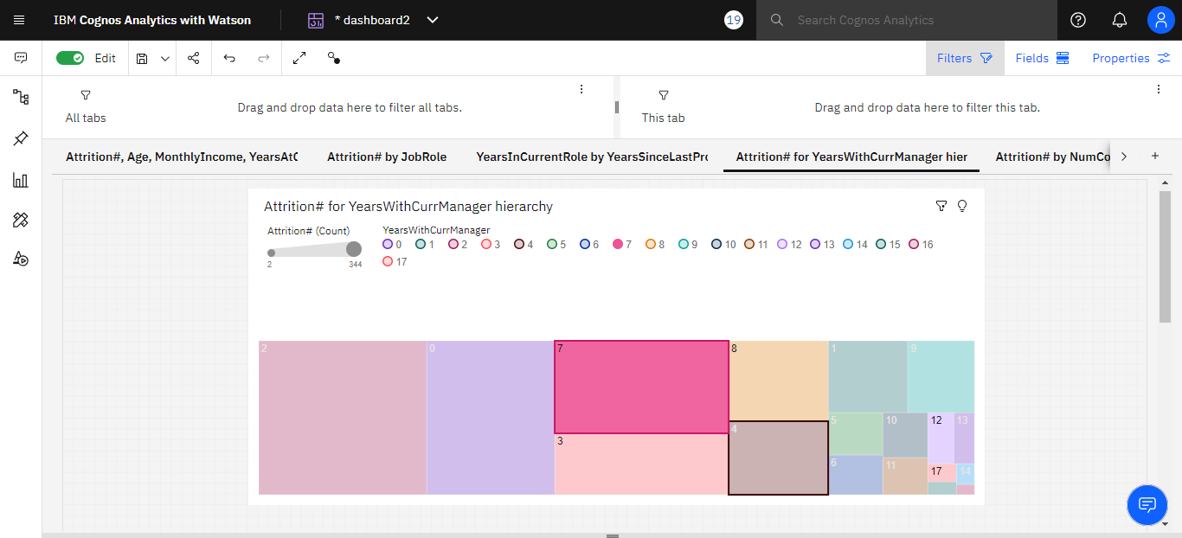
Figure 4: This page contains Attrition for Years with Current Manager Hierarchy

Slide 9
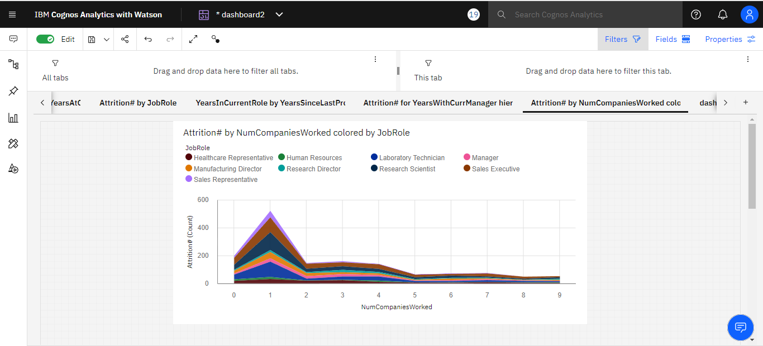
Figure 5: This figure shows the Attrition by No Of Companies
Worked Colored by JobRole

Slide 10
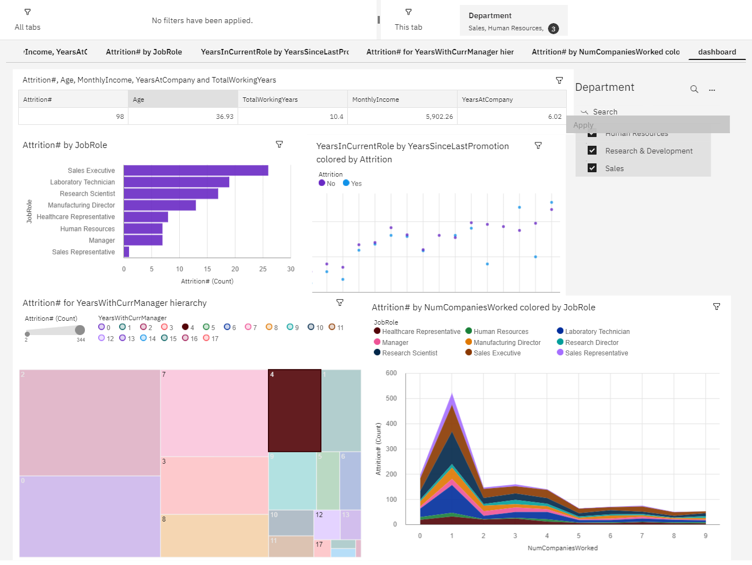
Figure 6: HR and People Analytics Dashboard

Slide 11
Conclusion
IBM Cognos Dashboard Embedded provides developers the ability to embed a visualization platform directly into their application.
We can create powerful and professional visualizations that explain the story of our data.
Protects the data from misuse. Self-service report authoring.

Slide 12


